Slide 1
Optimizing Entity Framework

Slide 2
Presenters
John Wiegert – Dev Lead for Portal Kombat
Bob Sakson – Software Engineer for Portal Kombat
PowerPoint and code can be found here:
https://github.com/bobsakson/EFOptimization

Slide 3
Examining the Generated EF Query

Slide 4
Quick and Dirty
Call ToString() on IQueryable

Slide 5
SQL Profiler
Quick and dirty – use the Tuning template
To further filter out the noise, filter the column name down to the account used by Entity Framework

Slide 6
Glimpse
Powerful performance tuning tool for ASP.NET
Installs via NuGet packages, many packages available, but we today we will demonstrate:
MVC5
EF6
Provides the capability to inspect previous requests
Notes:
Show model binding, timeline, configuration, cache (http cache items), server information, request information, also explain trace is for System.diagnostics.trace or debug messages during the request. Can set up a custom security policy for Glimpse. Talk about different packages needed for EF and MVC.
Show how transactions look in Glimpse, show the different tabs and how ajax for the current page shows up in ajax and you can set your context to there, show history with past requests. Show first get products which does all the duplicate queries (show how duplicates look in Glimpse)

Slide 7
Glimpse vs SQL Profiler
Why use one over the other?

Slide 8
Query Materialization
Deferred Execution
Immediate Execution – singletons and collections
Store Execution – materialized objects into query results
Notes:
https://msdn.microsoft.com/en-us/library/vstudio/bb738633(v=vs.100).aspx

Slide 9
Lazy vs Eager loading
Use includes when you know you need access to a related entity’s properties
Nested includes generate UNIONS
If you are going to loop over a related entity, it probably makes sense to use an include statement

Slide 10
Any|FirstOrDefault|Single
Which one should I use?

Slide 11
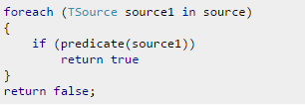
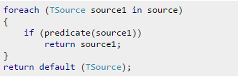
Any vs. FirstOrDefault
Any
FirstOrDefault
Which one is faster? It depends.
Notes:
http://stackoverflow.com/questions/8339988/performance-of-linq-any-vs-firstordefault-null

Slide 12
Query Strategies
AsNoTracking
Large sets
Read only
Bad practice of loading children through the parent
Notes:
Show AsNoTracking, talk about how this usually has a bigger impact on large sets of entities. I am using TransactionHistory which has 100k+ rows, so this is more pronounced. On my environment when I was testing before with change tracking this took about 2300 milliseconds, whereas with as no tracking it took about 700 ms
Show bad practice which is to load a parent just to get the children entities, should be pretty obvious, but just directly query the child table entities. Seems self-explanatory but I have seen this done many times, working with an ORM just makes this really easy to do since the children are right there. This has a really big negative effect if you have a large parent entity. An example I have seen before is people using a function that already existed in the service layer to load the parent to get the children because they didn't want to add a new service method to just get the children, but they didn't realize that original service method was actually doing about 10 includes for that huge parent entity, which was really killing performance.

Slide 13
DTO
When to use
When you only need a subset of columns
When you only need one property off a relation
Benefits
Leaner Queries
Less to materialize
Notes:
Show first get products which does all the duplicate queries, show a better way which is to include that relation, show best way which is to create a custom DTO that just gets the property you need so less data to materialize and less of a crazy union.

Slide 14
Nested Includes
Queries are changed to unions
Mitigation
Use DTO for getting columns you need
Some situations might make sense to do a separate query
Notes:
Show a multiple include scenario with nested includes and talk about how this is is a big increase in query complexity and results. 700 results from the first example, 20000 in the second, just from doing an nested include. Recommendation is to create a separate DTO for just what you need or to completely separately query that data and manipulate it together, separate connection but most likely the queries are faster without doing the unions.

Slide 15
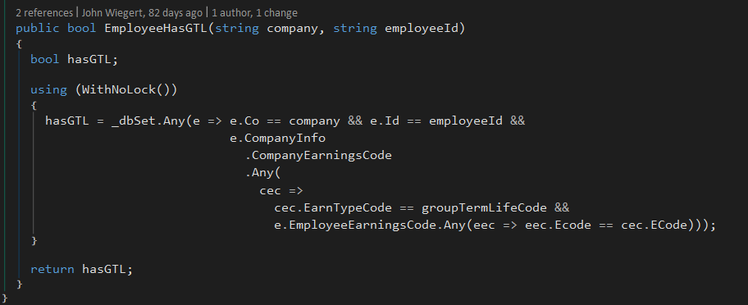
Nested Includes Cont.
Escher Example
Previously we were always including these relations
Separated to be an ad hoc function call
Notes:
For the above show the GTL example and talk about how before when we were loading the employee info record we were including these extra tables just to check if the employee had GTL for validation purposes on a birth date. This was making every read of the employee info record huge since it had basically three extra includes so abstracted to be its own function for only when it is being saved. Think of the most common use case, which for us was going to be basic reads of data, the item needed for validation sometimes wasn't worth always including.

Slide 16
AutoDetectChanges
Disables change tracking for the whole context instead of for a set
Only use for a read-only context
Disabling turns off the EF validation on entities when updating
ValidateOnSave
Notes:
Talk about how autodetect changes works very similar to asNoTracking, however as no tracking works on the set/query level, whereas the autodetectchanges off is on the whole context so if you do need to do updates, changes will not be tracked.
Mention about autodetectchanges and validate on save false not helping in my insert example with EF6, but that in the past it has helped me a lot, and to just keep it in mind for your use case if you are already doing other validation anyway (also mention about batching the saves for large updates/inserts).

Slide 17
Batching Updates/Inserts
In some situations offers performance improvement
SaveChanges on large amount of changes can timeout

Slide 18
Entity Framework Challenges with Escher

Slide 19
Relationships based on Co and Id
No foreign key defined on these columns
Manually created mappings between entities took some trial and error
Unforeseen benefit of joining two somewhat unrelated entities together to short circuit queries (e.g. Einfo.Coptions instead of Einfo.Cinfo.Coptions)
Using Co and Id as the keys is not always consistent (Einfo and EInfoPending)

Slide 20
Co and Id Casing Inconsistences
Escher uses the COLLATE SQL_Latin1_General_CP1_CI_AS collation
TSQL query considers a Co or Id value of ‘ABCDEF’ the same as ‘abcdef’, so case does not matter when joining on these columns
.NET CLR is case sensitive and will not materialize a relationship between two entities if a casing inconsistency exists
Most likely caused by client imports and/or manual update scripts
Can be corrected with a view – unless you need to insert data
Determined that there were ~600k rows of data within the scope of entities used. Updated the data over 2 nights

Slide 21
Paycheck History Data
EPayHist and EPayHistDetail reside in EscherHistory
Data goes back to 1997
Want to avoid cross database and cross server joins for performance
Created two contexts:
EscherHistory for the bulk of the data
Escher for lookup values
Materialize queries from both contexts, then work on in-memory objects

Slide 22
Questions?

